Slide 1
Machine learning for biology workshop
Fangzhou Mu
Chris Magnano
Anthony Gitter

Slide 2
After the workshop, you will…
Know what machine learning (ML) does and why it can be useful in biological research.
Be able to read papers that apply (simple) ML to biological problems.
Understand (some of) the language used by computational biologists and be more comfortable to collaborate with them.
Be prepared to explore opportunities of applying ML in your own projects.

Slide 3
We will cover…
An introduction to ML
Motivation
Tasks (we will focus on classification)
The basics of ML
ML vocabulary
Typical ML workflow
Some simple (but popular) classification models
Neural Networks, Random Forests, Support Vector Machines, Naïve Bayes …
Evaluation of classifier performance
Metrics
Plots
Hands-on practice with toy and real datasets

Slide 4
We will NOT cover…
Coding
We will click on buttons in a user-friendly software.
Math
Math only appears when it is absolutely needed.
However, it can still be intimidating when it shows up.
We will focus on intuition, not calculation.
Feature engineering
We primarily study the “core” of ML.
However, engineering tricks are critical to the success of ML in practice.
Highly domain specific, a lot of folk wisdom, no universal guideline, coding required.
The state-of-the-art models at the frontier of ML/bioinformatics research
Too much math and coding involved, not appropriate for beginners

Slide 5

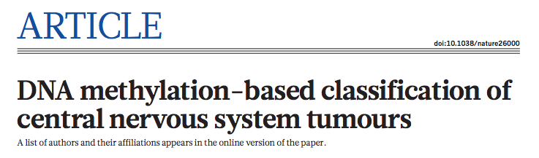
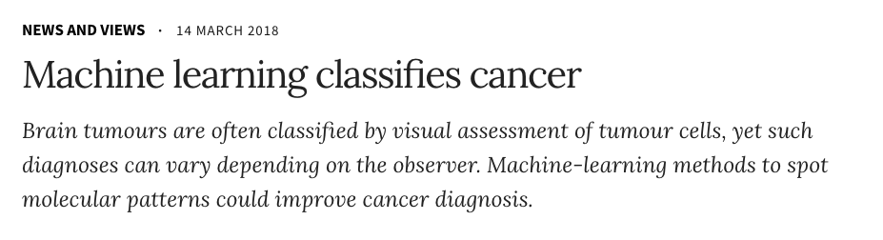
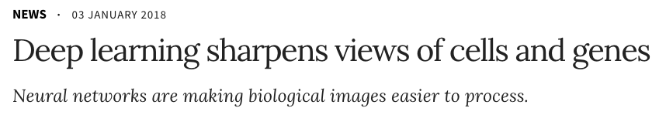
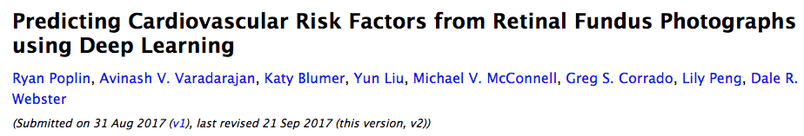
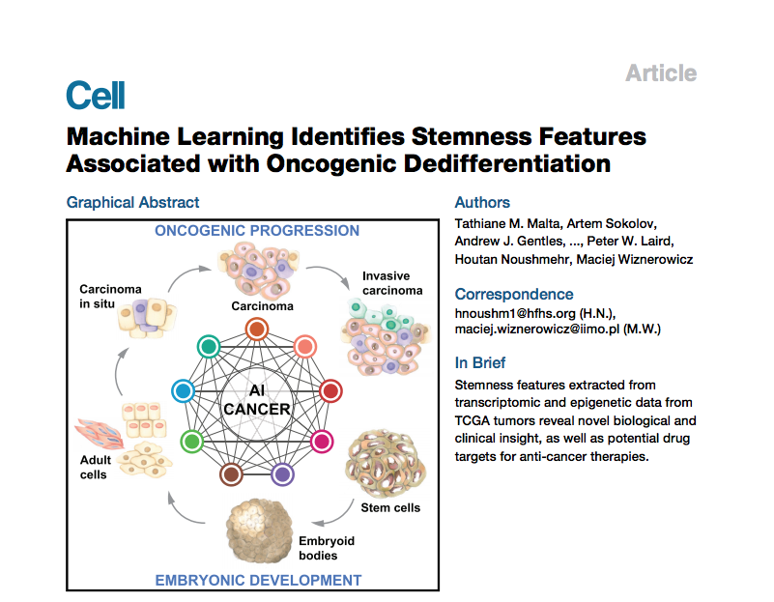
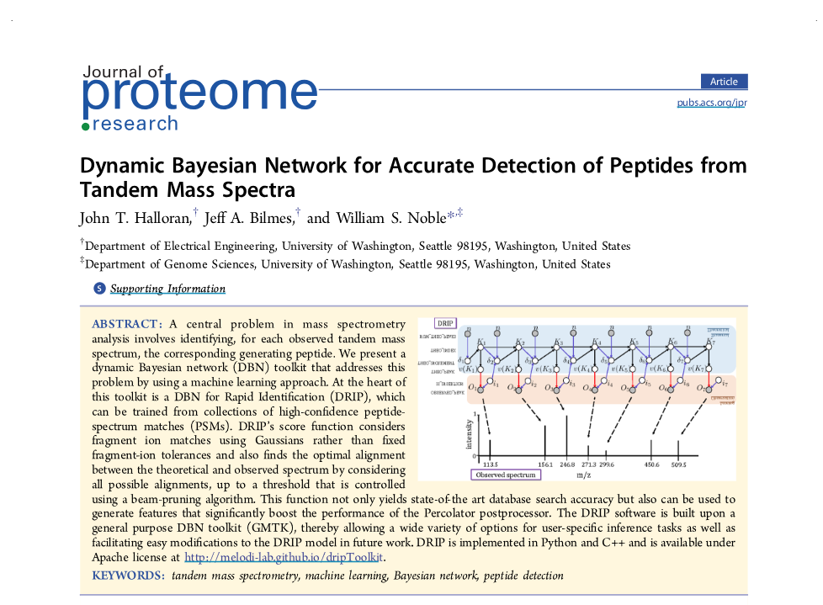
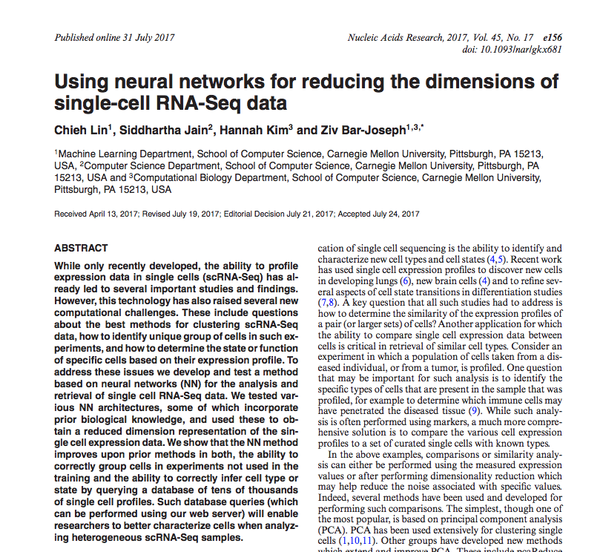
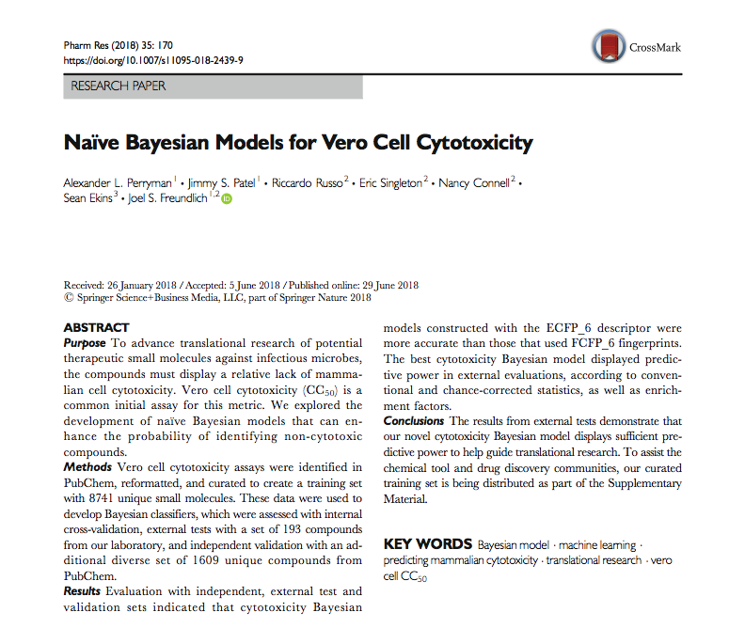
ML in biology
Nature. 2018 Mar 22;555(7697):469-474.
https://www.nature.com/articles/d41586-018-02881-7
https://www.nature.com/articles/d41586-018-00004-w
arXiv:1708.09843v2 [cs.CV]
Cell. 2018 Apr 5;173(2):338-354.e15.
Nucleic Acids Res. 2017 Sep 29;45(17):e156.
J Proteome Res. 2016 Aug 5;15(8):2749-59.
Pharm Res. 2018 Jun 29;35(9):170.

Slide 6
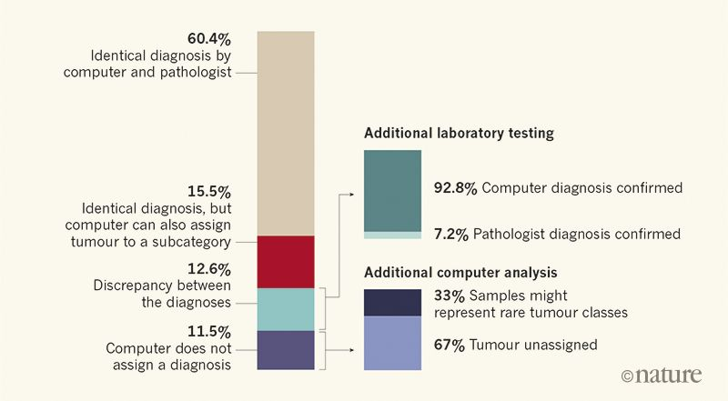
ML in biology
Samples:
2801 genome-wide DNA methylation profiles of tumor samples from patients
Features:
Intensities of methylation signal at ~450,000 target sites in the genome
Labels:
Tumor types
Machine learning
Classifier:
A random forest classifier with ~10,000 trees
What was learned?
https://www.nature.com/articles/d41586-018-02881-7
Why it matters?
Lower cost
Higher diagnostic precision
Insight into grouping of tumor types

Slide 7
Brainstorming! What data do you generate in the lab? What do you want to learn from your data? Why it matters?
Practice

Slide 8
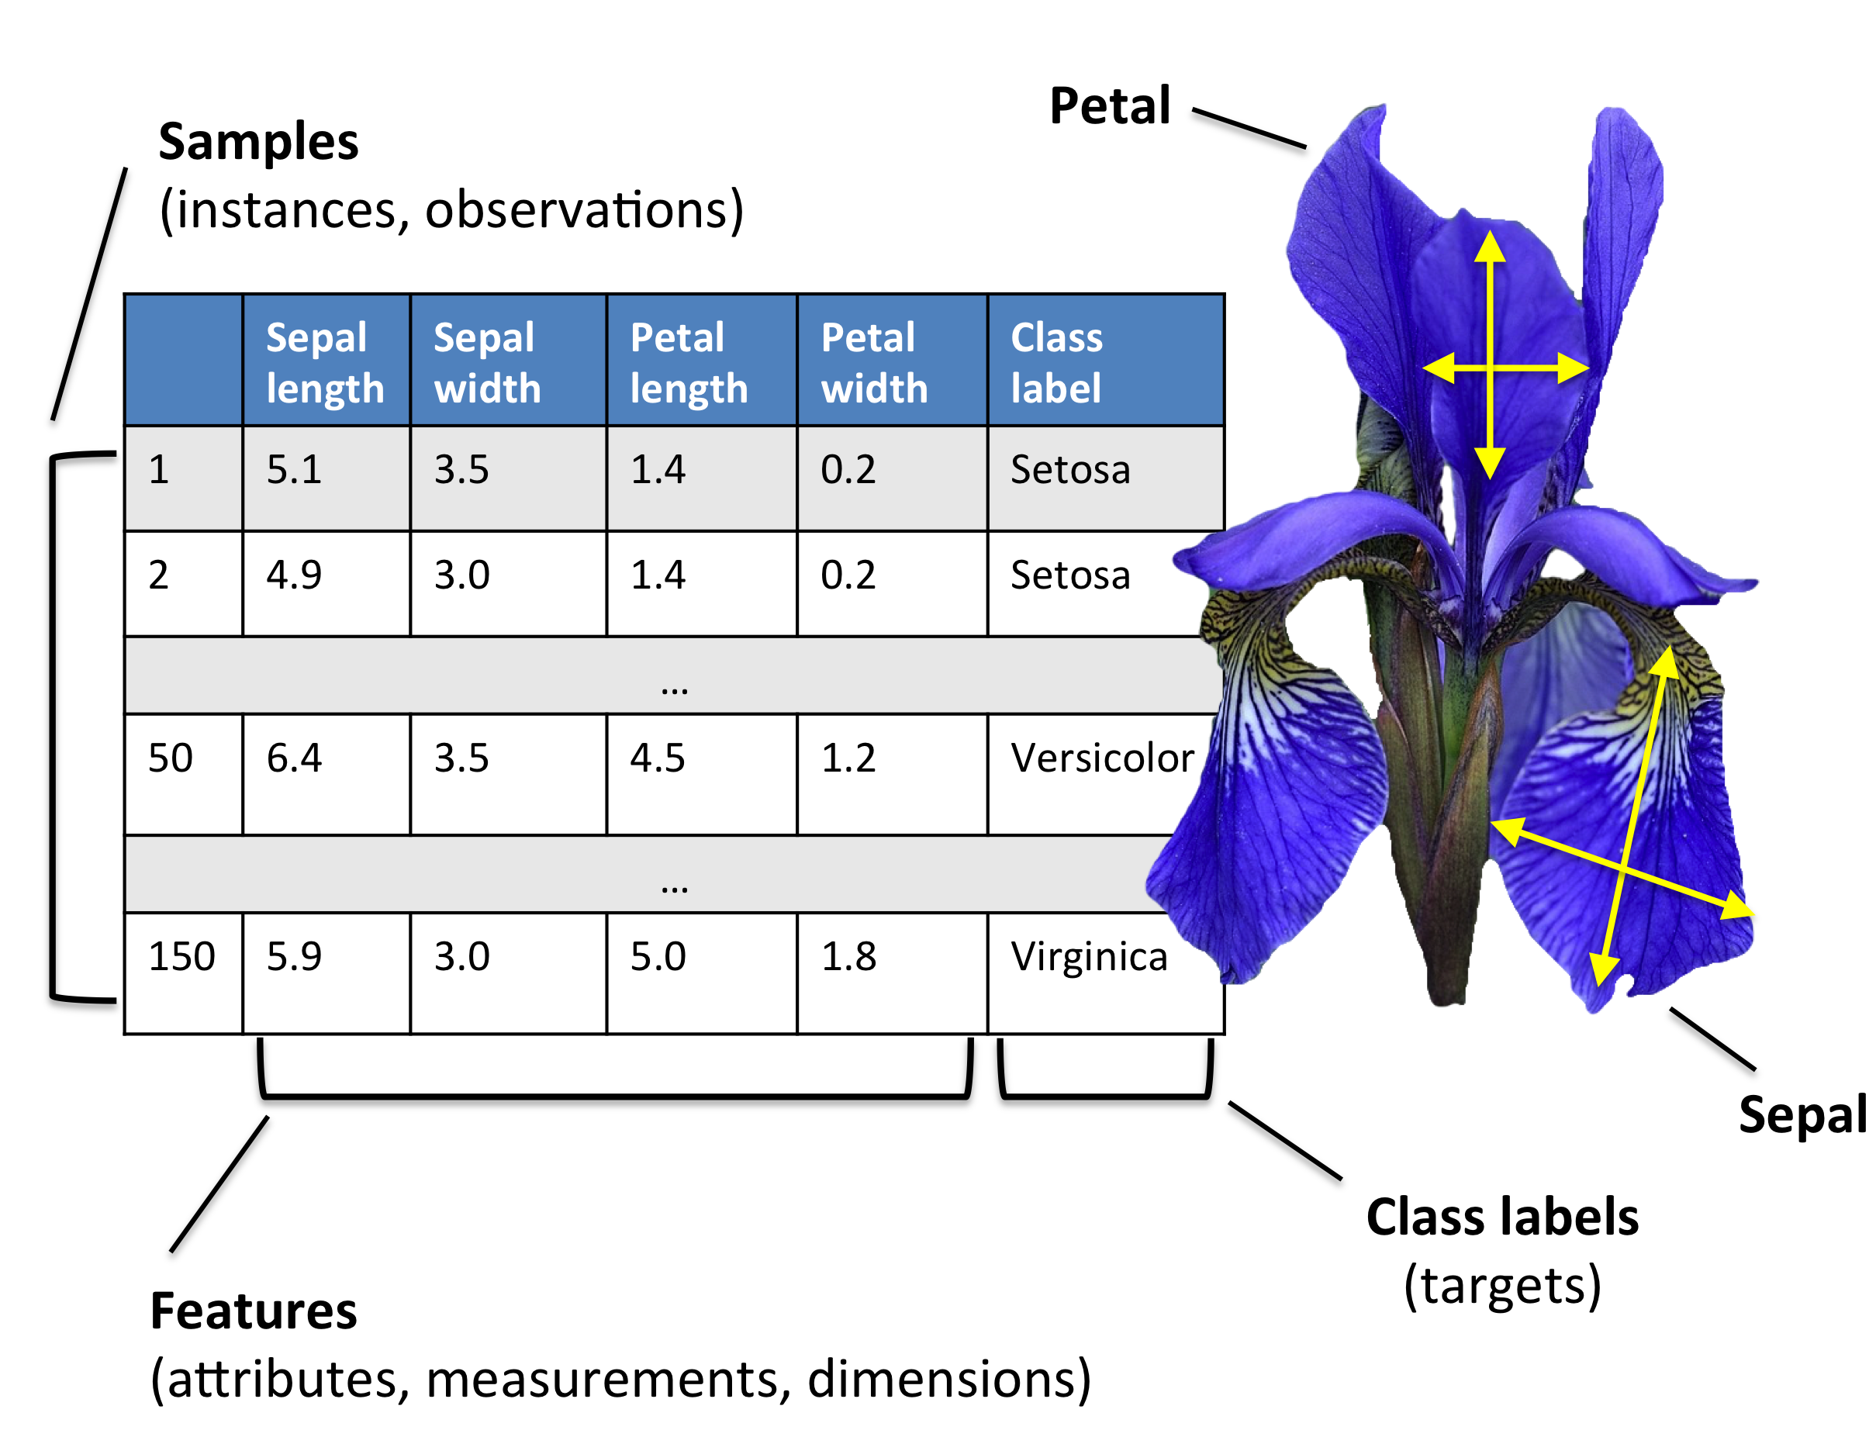
Dataset
Image from
https://github.com/rasbt/python-machine-learning-book-2nd-edition
S. Raschka and V. Mirjalili, Python Machine Learning (2nd Ed.)

Slide 9
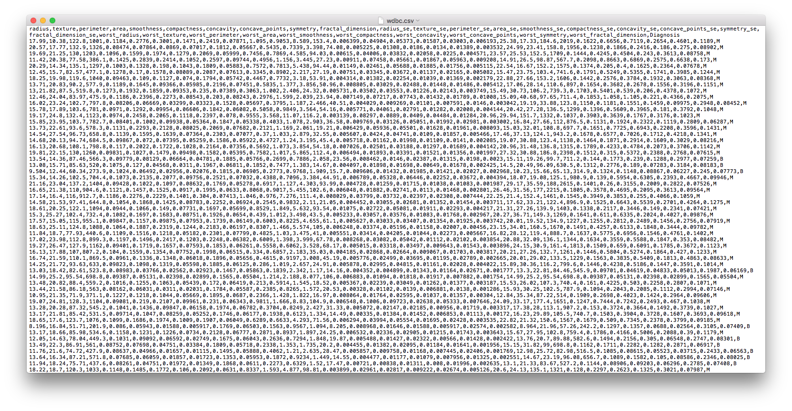
Dataset
A typical .csv file:

Slide 10
Open the telomere ALT dataset (telomere.csv) What do the rows represent? What are the features? How many classes are there?
Practice

Slide 11
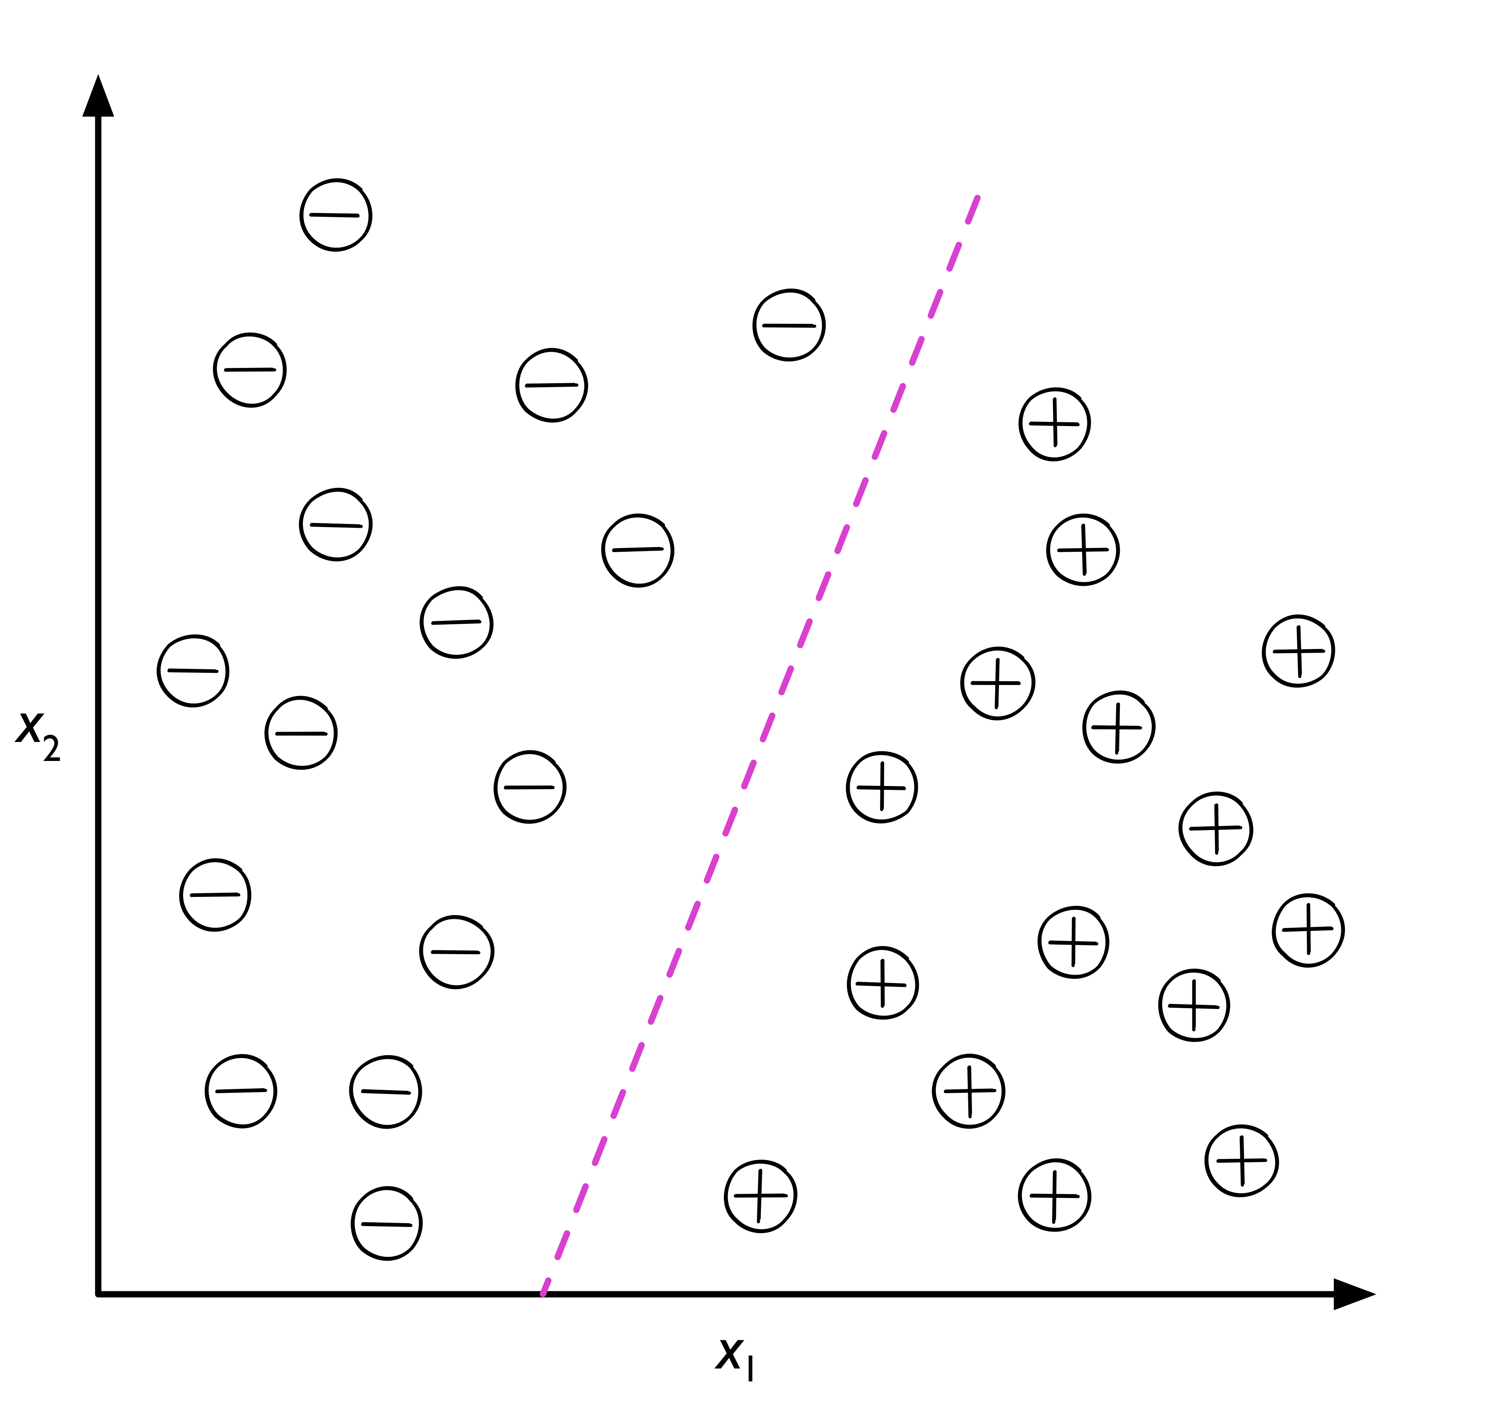
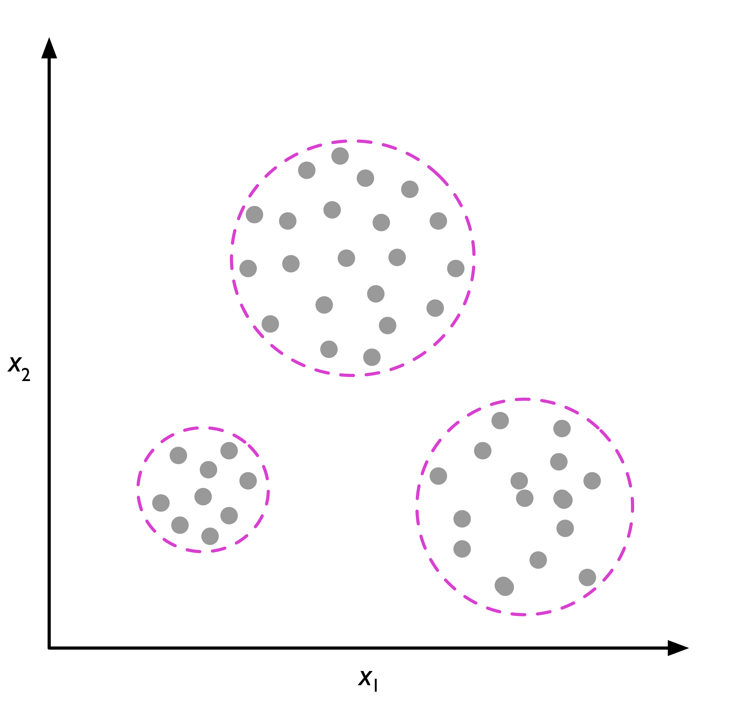
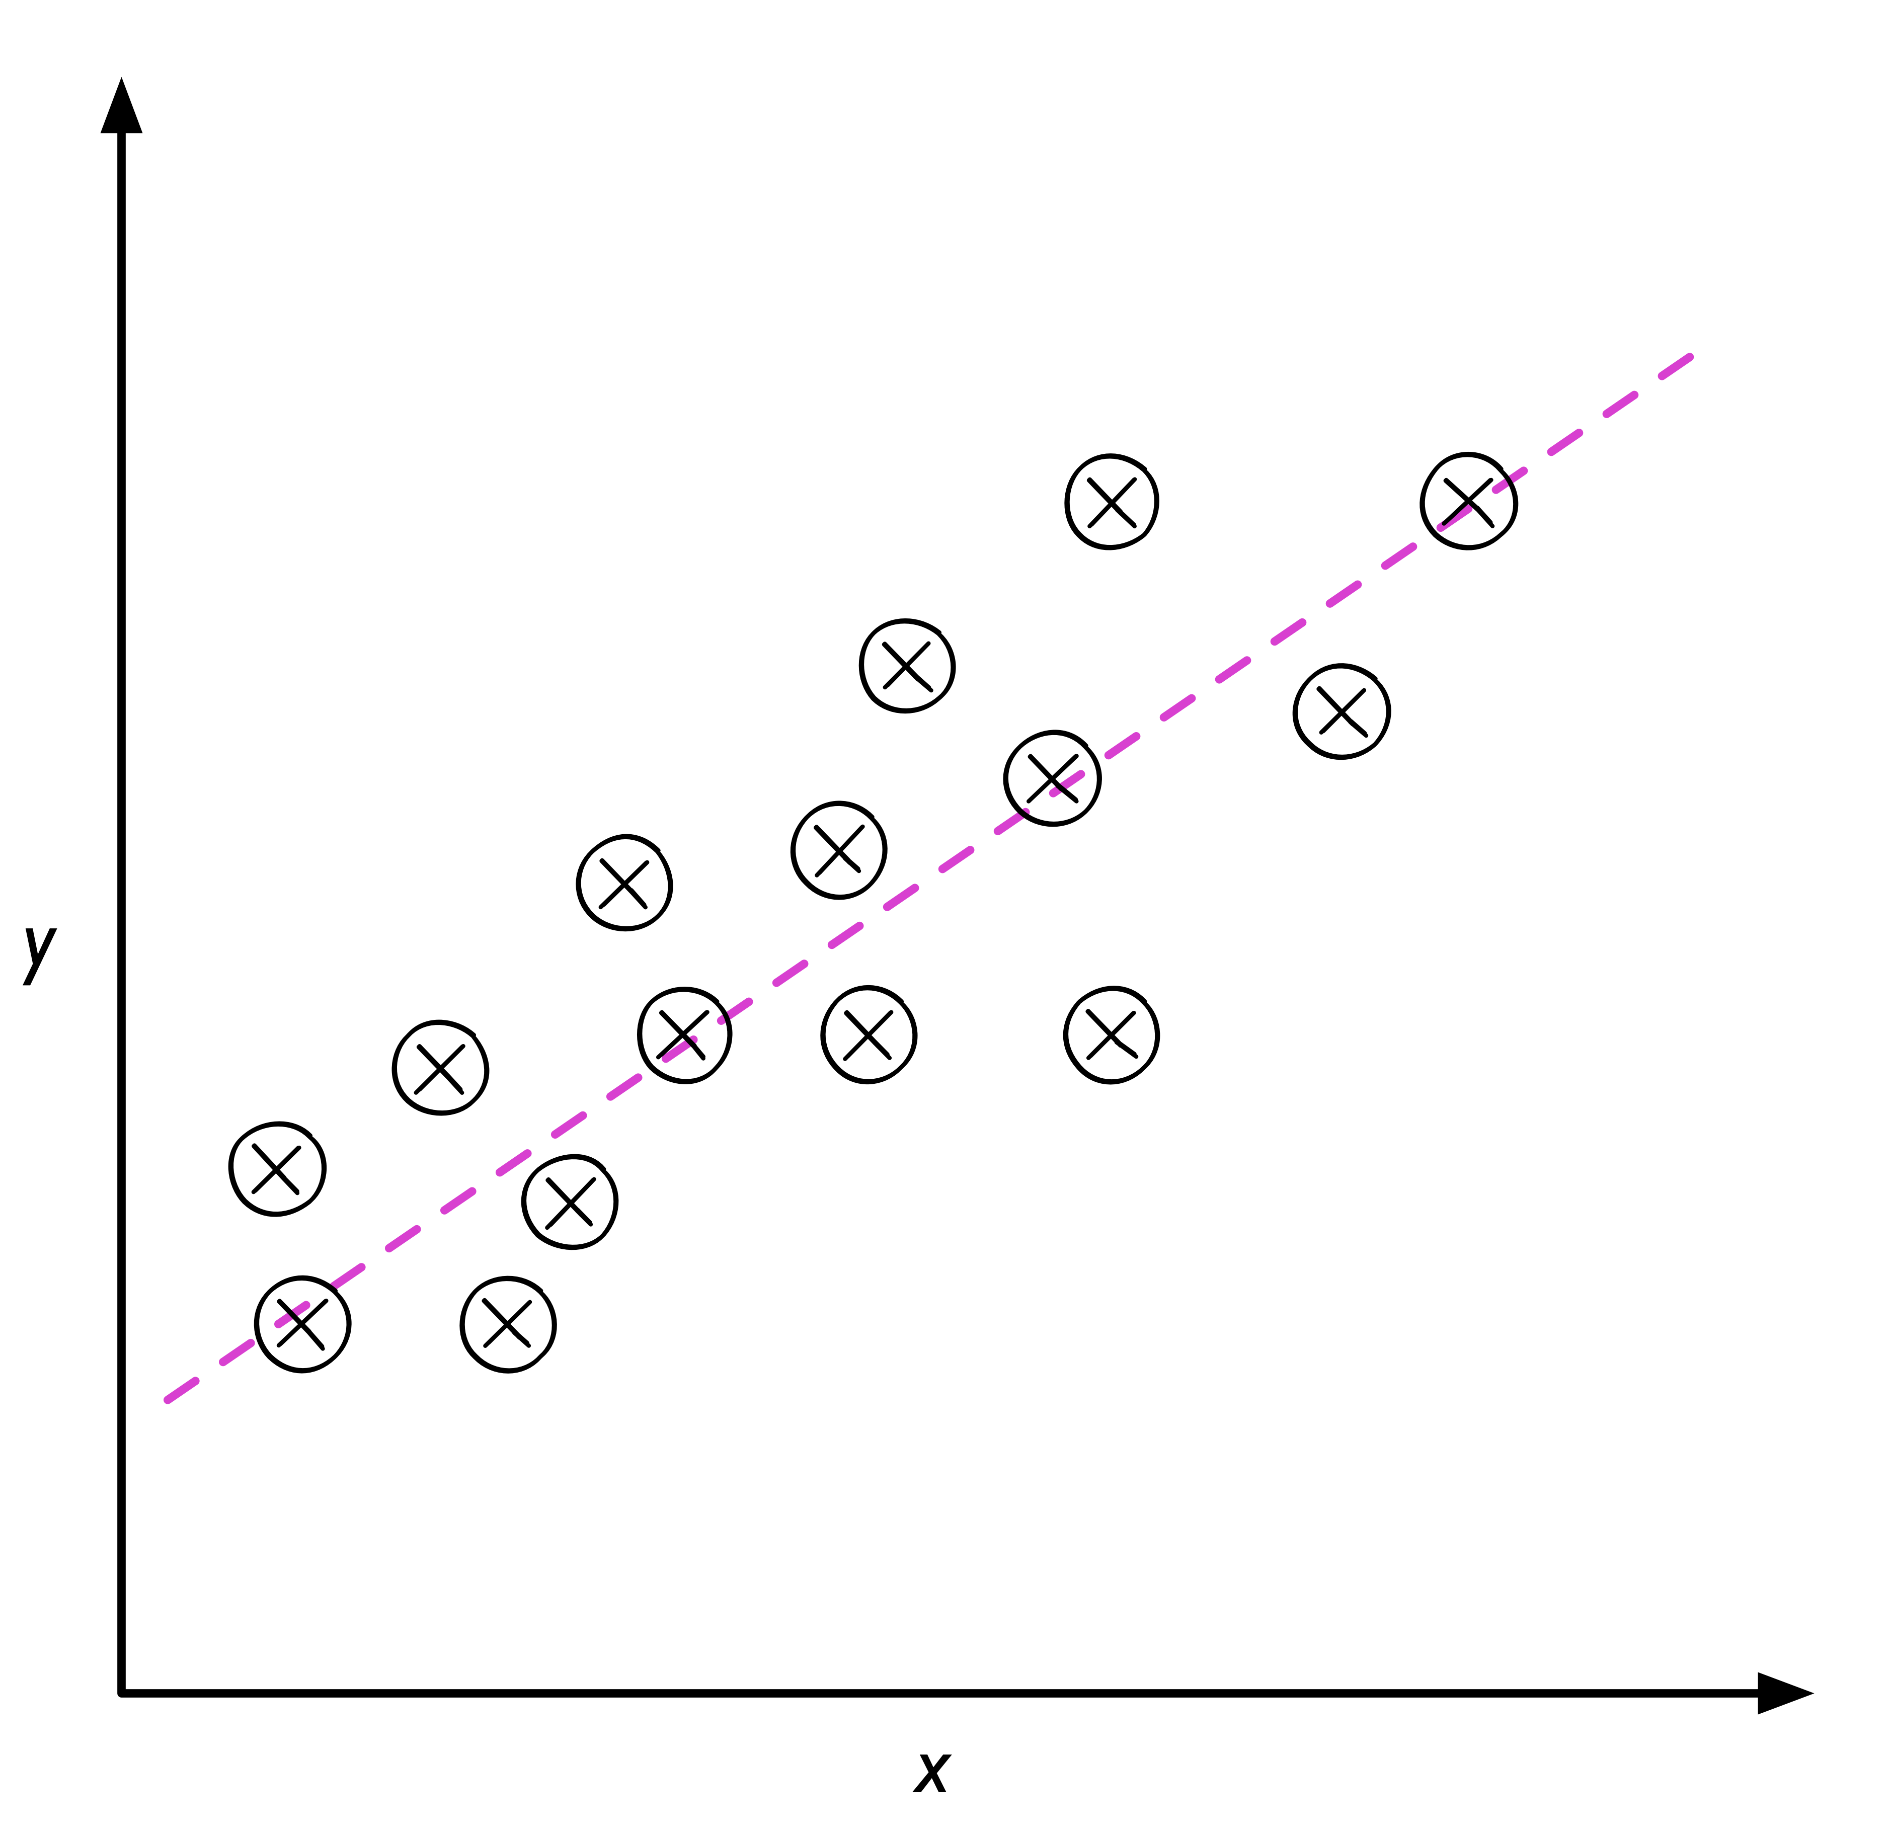
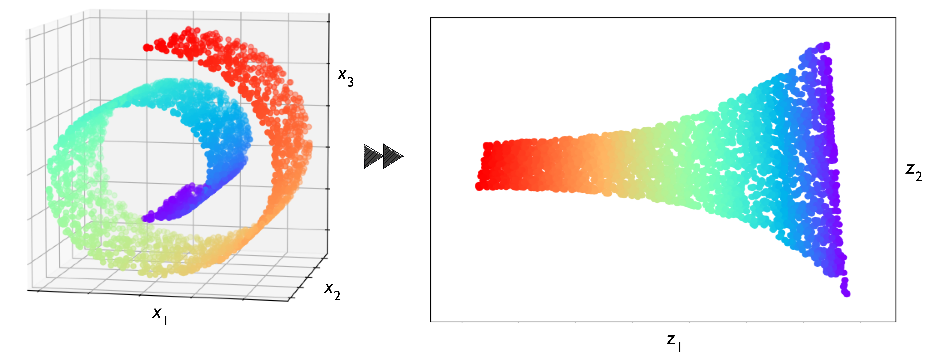
ML tasks
Supervised learning
Unsupervised learning
Classification
Clustering
Regression
Dimensionality reduction
Images from
https://github.com/rasbt/python-machine-learning-book-2nd-edition
S. Raschka and V. Mirjalili, Python Machine Learning (2nd Ed.)

Slide 12
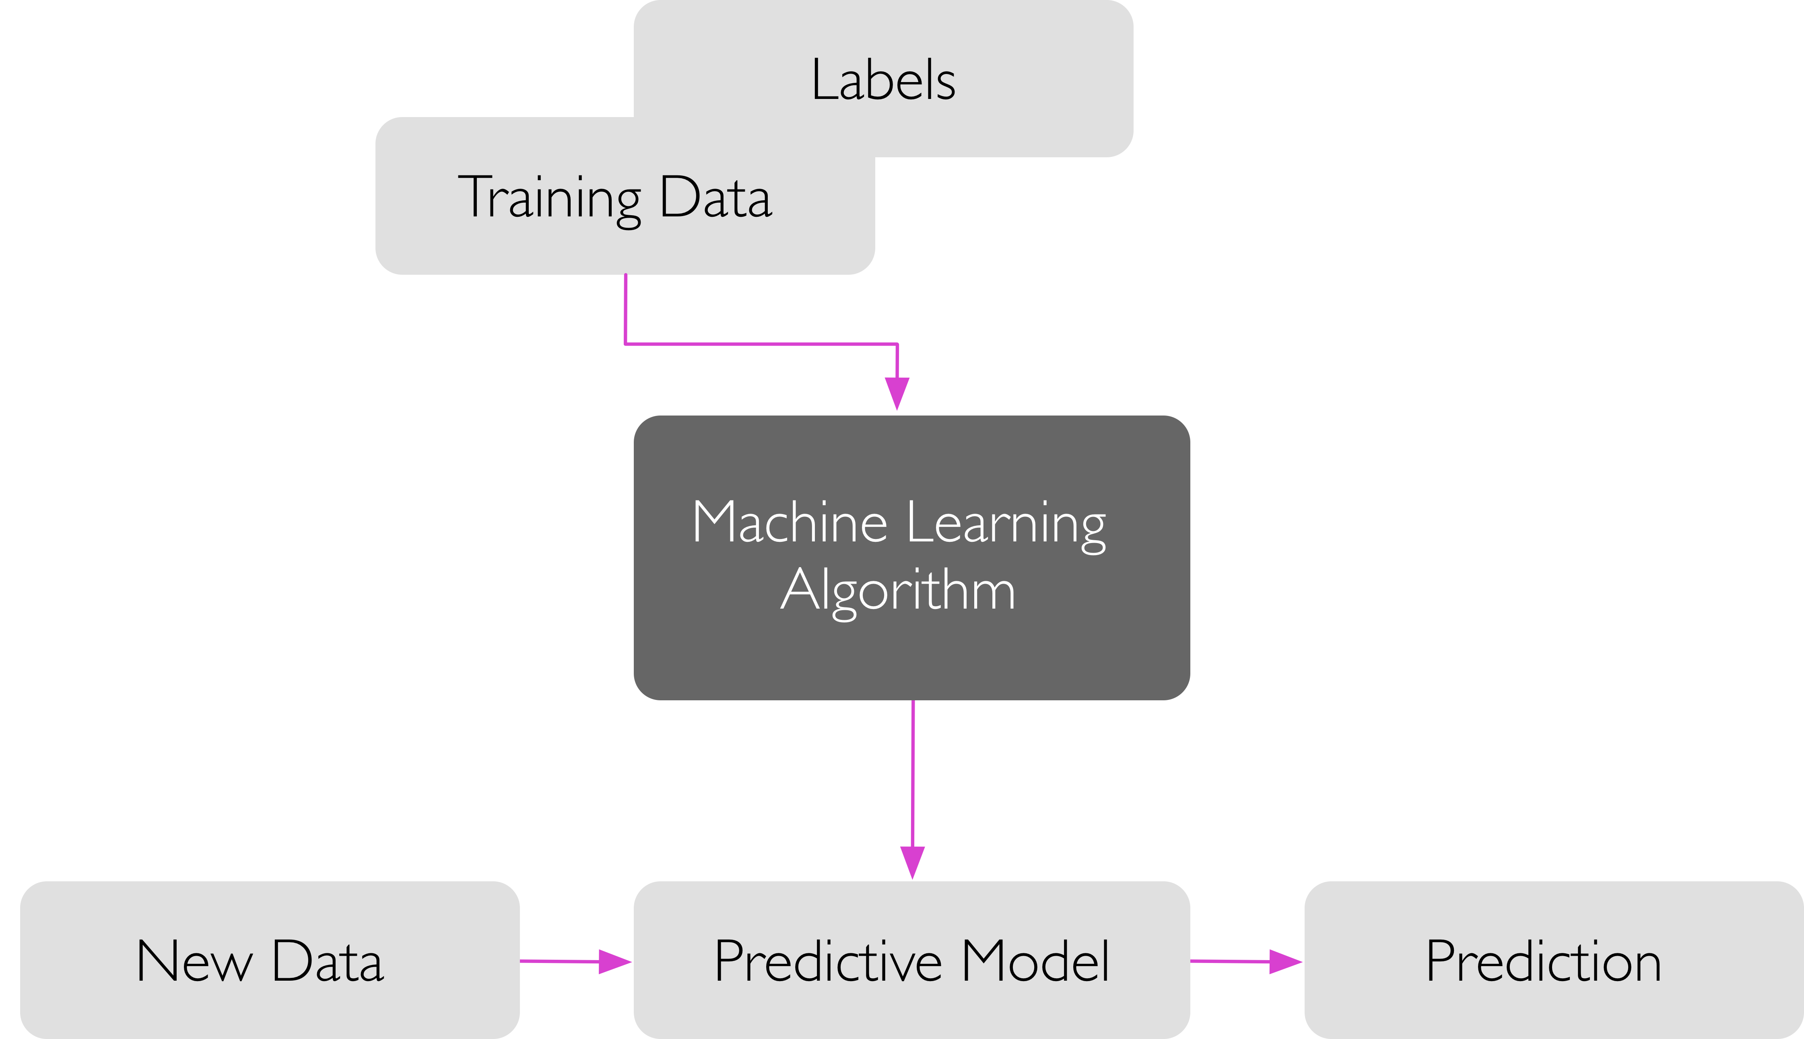
Models: Training and Inference
Training
Inference
Image from
https://github.com/rasbt/python-machine-learning-book-2nd-edition
S. Raschka and V. Mirjalili, Python Machine Learning (2nd Ed.)

Slide 13
Get hands dirty! Load telomere ALT datasets in ML4BIO software Train some classifiers Predict labels for new data
Practice

Slide 14
ML workflow
Image from
https://github.com/rasbt/python-machine-learning-book-2nd-edition
S. Raschka and V. Mirjalili, Python Machine Learning (2nd Ed.)

Slide 15
Step 1: Preprocessing
Before training a classifier, raw data needs to be
Transformed (images, sequences, text, spectra)
Cleaned (missing values, typos, inconsistency)
Combined (date from different sources/modalities)
Normalized (batch effect, features in different scales)
Encoded (categorical features)
Feature engineering
Feature selection

Slide 16
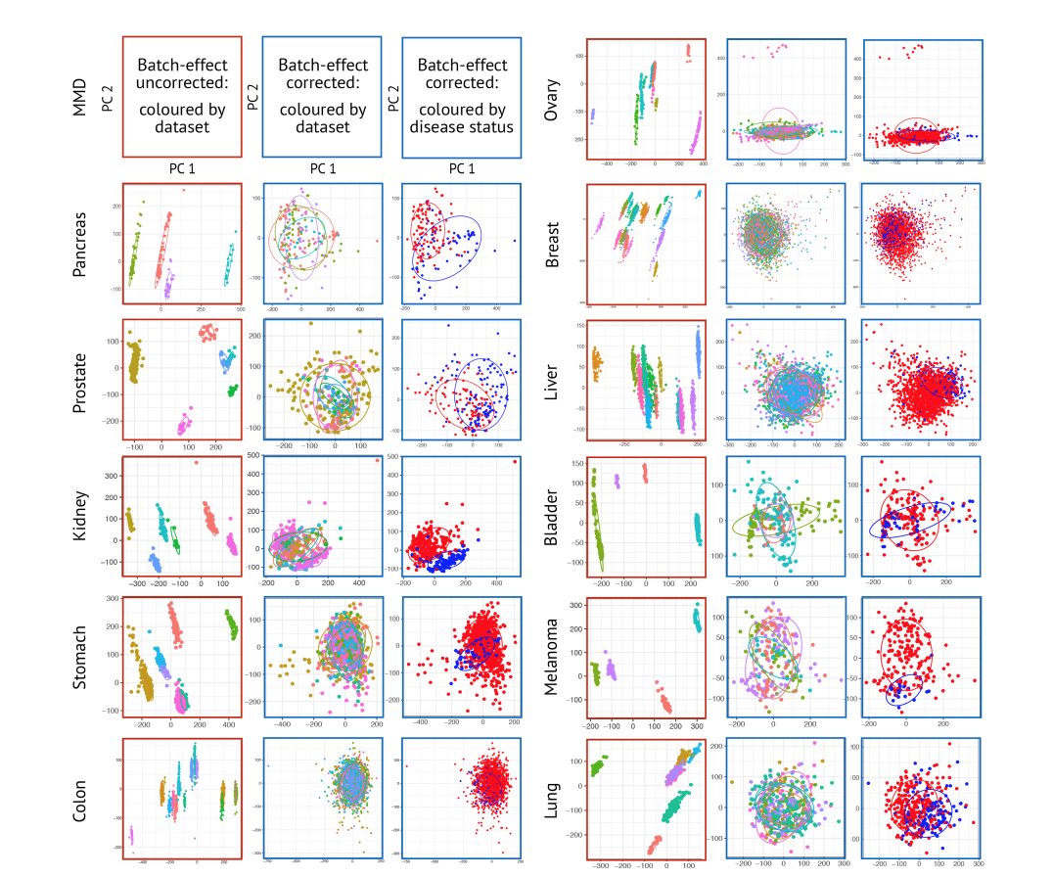
Data normalization
Su Bin Lim, Swee Jin Tan, Wan-Teck Lim, Chwee Teck Lim.
Compendiums of Cancer Transcriptome for Machine Learning Applications
BioRxiv 353698 [Preprint]. June 22, 2018 Available from: https://doi.org/10.1101/353698

Slide 17
Data encoding
shape | size | extravasation | class
bean | small | yes | cancer
oval | large | yes | normal
bean | small | no | cancer
round | medium | no | normal
oval | medium | no | cancer
bean | oval | round
1 | 0 | 0
0 | 1 | 0
1 | 0 | 0
0 | 0 | 1
0 | 1 | 0
size
0
2
0
1
1
extravasation
1
1
0
0
0
class
1
0
1
0
1
One-hot encoding
Integer encoding

Slide 18
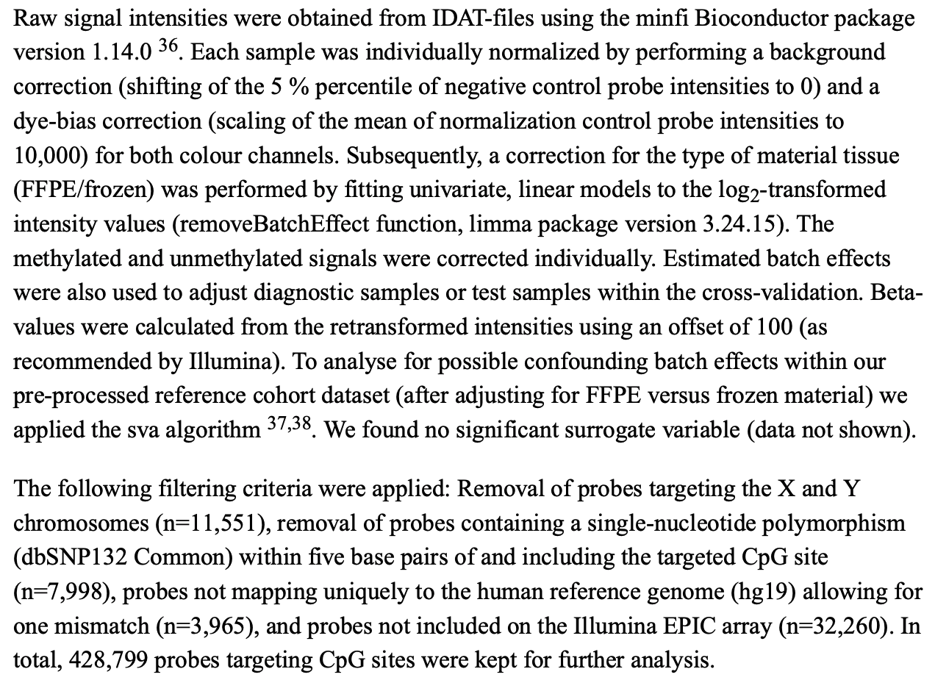
What are the preprocessing steps? What issue does each step address?
Practice
Nature. 2018 Mar 22;555(7697):469-474.
Data preprocessing

Slide 19
Step 2: Learning
Training
Choose classifier type
Set hyperparameters (if applicable)
Apply a learning algorithm
Validation
Estimate classifier performance
Hyperparameter optimization
Classifier selection

Slide 20

Training
Classifier types
Logistic Regression
Neural Networks
Decision Trees
Random Forests
Support Vector Machine (SVM)
K-Nearest Neighbors (if time permits)
Naïve Bayes (if time permits)
Learning algorithms
Optimization of an objective function
A lot of math behind
Image from
https://blog.paperspace.com/intro-to-optimization-in-deep-learning-gradient-descent
A. Kathuria, Intro to optimization in deep learning: Gradient Descent

Slide 21
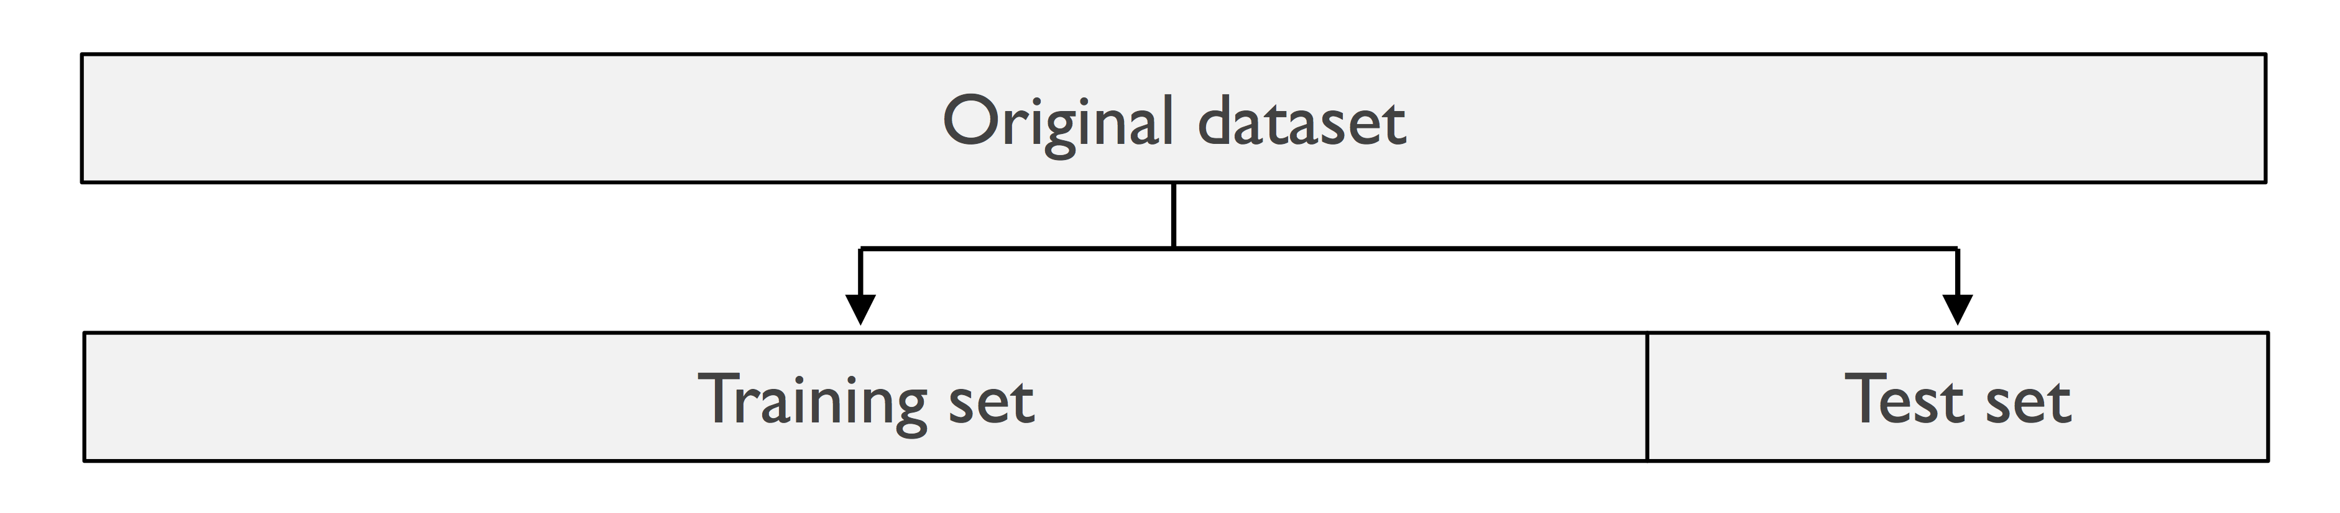
Train/test split
Image adapted from
https://github.com/rasbt/python-machine-learning-book-2nd-edition
S. Raschka and V. Mirjalili, Python Machine Learning (2nd Ed.)

Slide 22
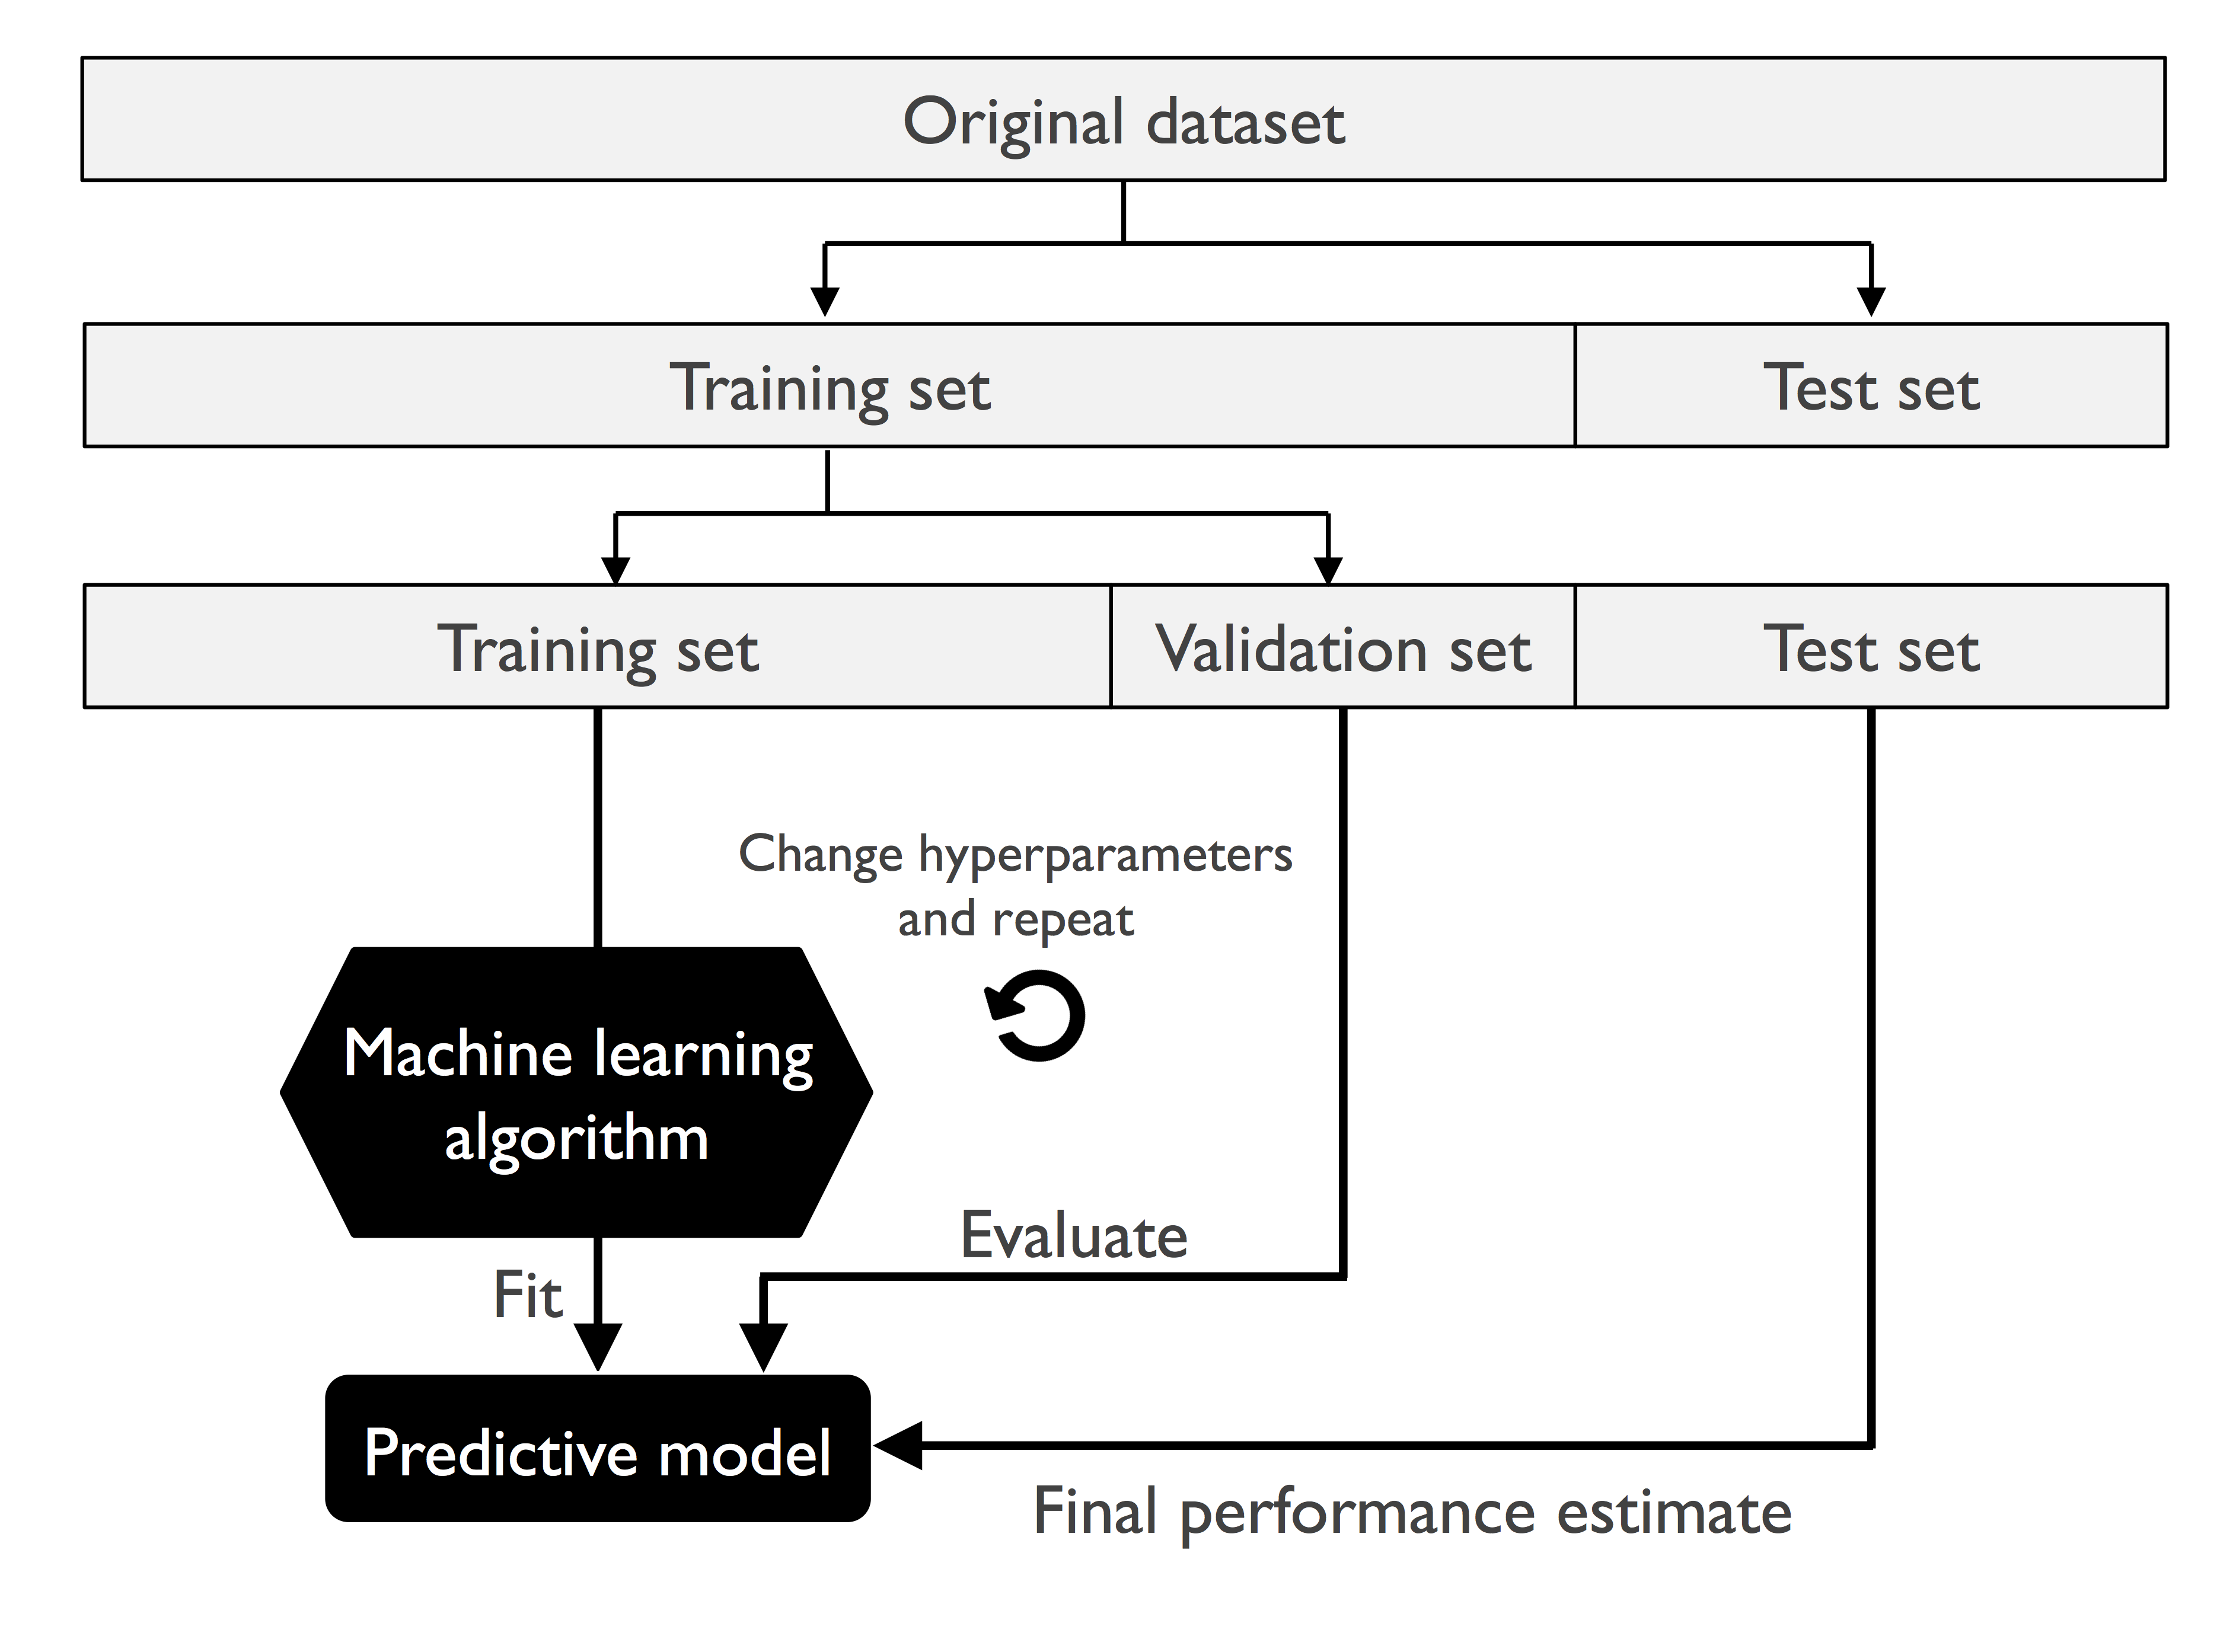
Validation
Hold-out validation
Image from
https://github.com/rasbt/python-machine-learning-book-2nd-edition
S. Raschka and V. Mirjalili, Python Machine Learning (2nd Ed.)

Slide 23
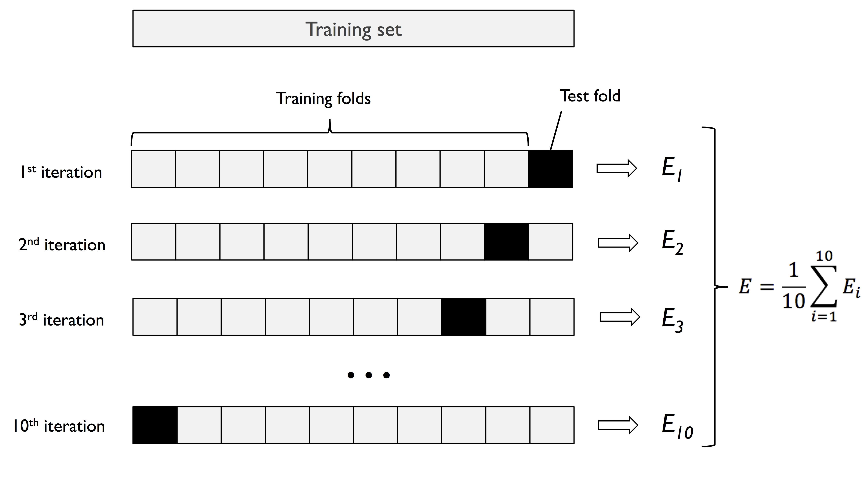
Validation
K-fold cross-validation
(fold: the number of subsets the training set is divided into)
K = 10
Image from
https://github.com/rasbt/python-machine-learning-book-2nd-edition
S. Raschka and V. Mirjalili, Python Machine Learning (2nd Ed.)

Slide 24
Data splitting Load toy_data_1.csv. (a) Vary train/validation ratio in hold-out validation. (b) Vary K in K-fold variation. Train a logistic regression classifier with default setting. When do you achieve best validation accuracy?
Practice

Slide 25
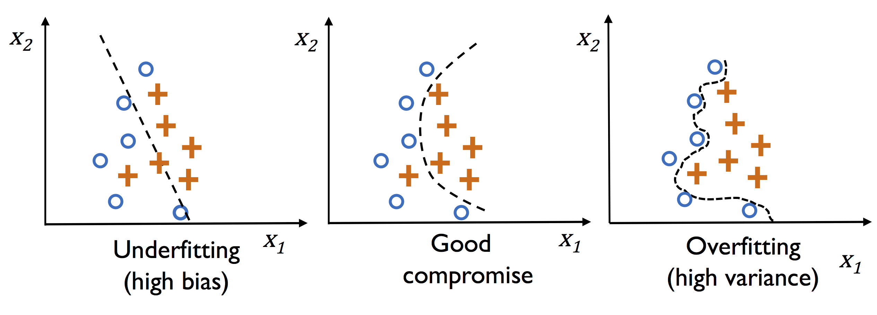
Underfitting and Overfitting
Image from
https://github.com/rasbt/python-machine-learning-book-2nd-edition
S. Raschka and V. Mirjalili, Python Machine Learning (2nd Ed.)

Slide 26
Overfitting Load toy_data_6.csv. Hold out 20% data for validation. Train an SVM with the following settings: (a) RBF kernel, (b) RBF kernel, How well do training accuracy agree with validation accuracy? Why? Hold out 0% data for validation (i.e. no validation set). Train an SVM with setting (b) above. How well do training accuracy agree with test accuracy? Why is validation set important?
Practice

Slide 27
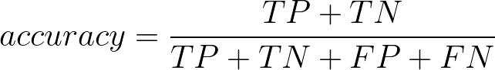
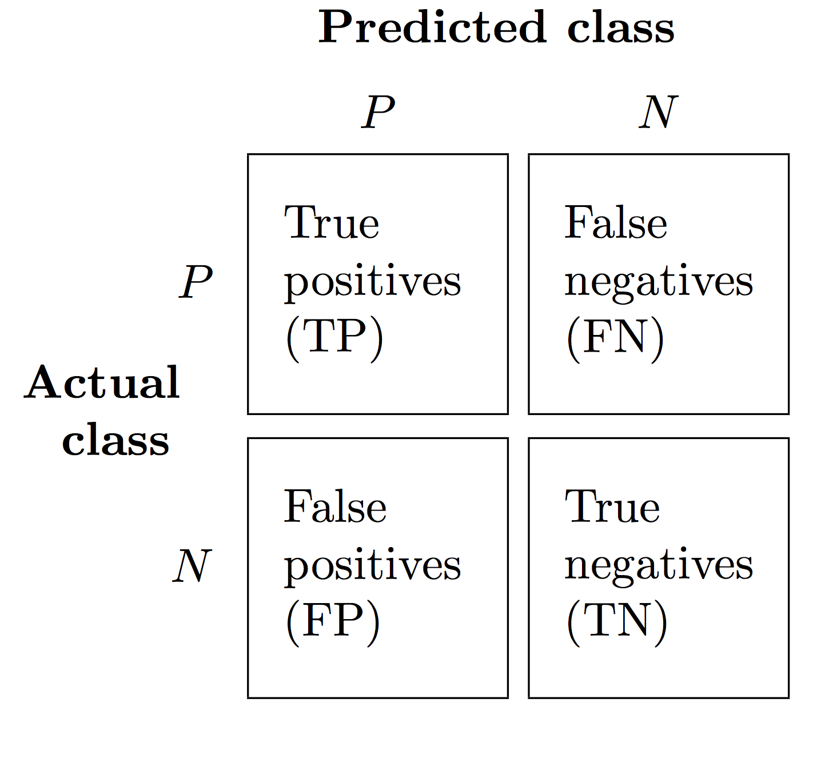
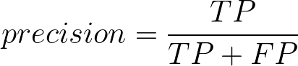
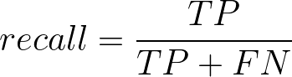
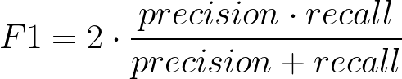
Performance Metrics
Image from
https://github.com/rasbt/python-machine-learning-book-2nd-edition
S. Raschka and V. Mirjalili, Python Machine Learning (2nd Ed.)

Slide 28
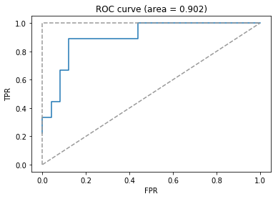
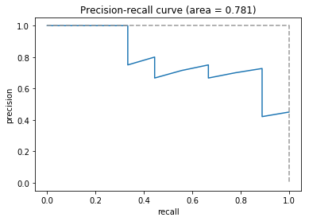
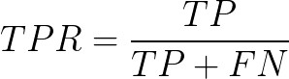
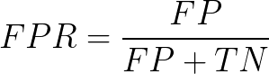
Plots
Receiver operating characteristic (ROC) curve
Precision-recall curve

Slide 29
Performance metrics TBD
Practice

Slide 30
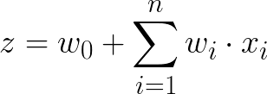
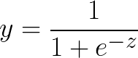
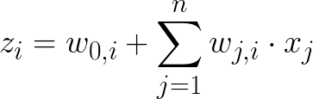
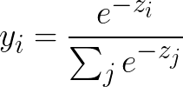
Logistic Regression: Representations and Inference
1
w₀
Binary setting
x₁
w₁
w₂
z
logistic
y
0.86
x₂
w_{n}
…
x_{n}
1
Multi-class setting
(e.g. 3 classes)
z₁
y₁
0.76
x₁
z₂
softmax
y₂
0.05
x₂
…
z₃
y₃
0.19
x_{n}

Slide 31
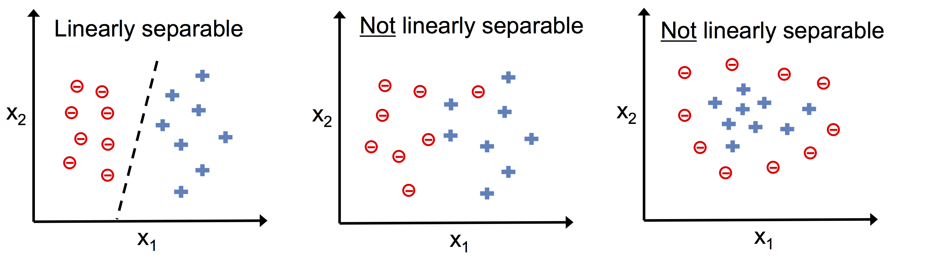
Linearly Separable vs. Not Linearly Separable
Image from
https://github.com/rasbt/python-machine-learning-book-2nd-edition
S. Raschka and V. Mirjalili, Python Machine Learning (2nd Ed.)

Slide 32
Linear separability Can logistic regression perfectly fit a non-linearly separable dataset? Why?
Practice

Slide 33
Neural Network: Representations
1
1
x₁
a₁
c₁
z
logistic
y
0.73
Binary
x₂
activation function
(linear, relu, logistic, tanh)
a₂
c₂
…
x_{n}
a₃
c₃
Input layer
Hidden layer
Output layer
Prediction

Slide 34
Neural Network: Representations
1
1
z₁
y₁
0.09
x₁
a₁
c₁
z₂
y₂
0.05
softmax
Multiclass
(e.g. 4 classes)
x₂
activation function
(linear, relu, logistic, tanh)
a₂
c₂
z₃
y₃
0.62
…
x_{n}
a₃
c₃
z₄
y₄
0.24
Input layer
Hidden layer
Output layer
Prediction

Slide 35
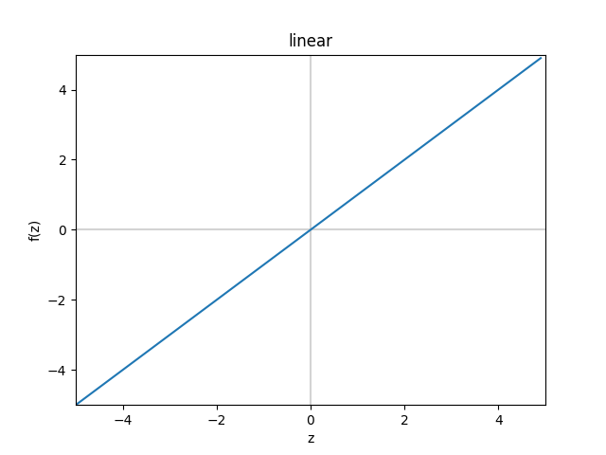
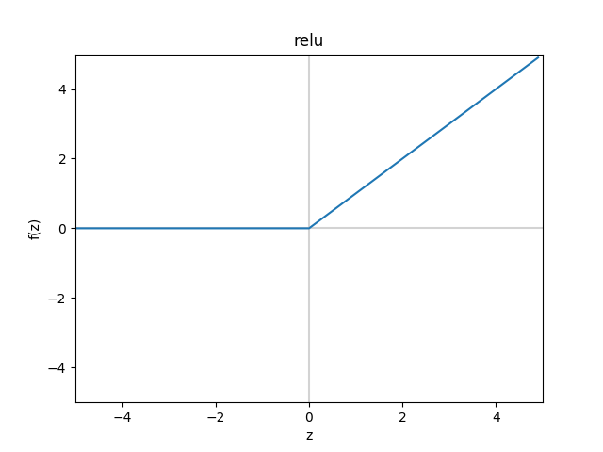
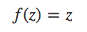
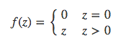
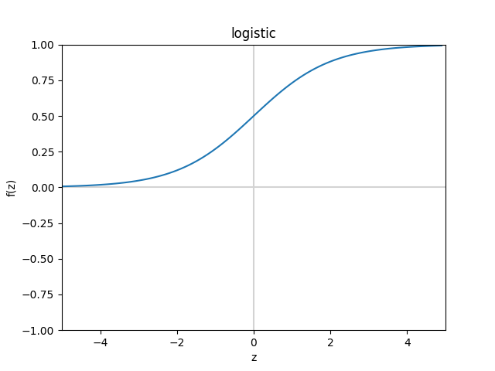
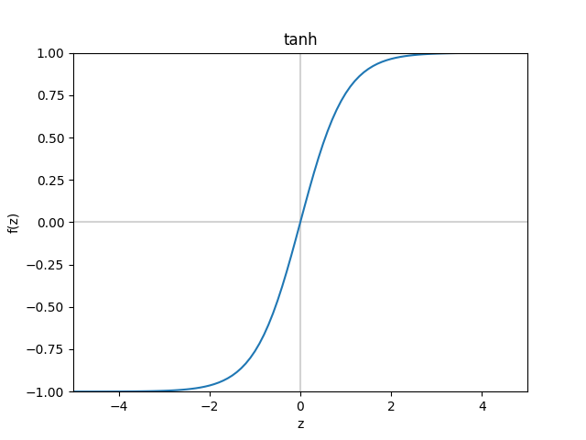
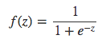
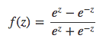
Logistic Regression & Neural Network: Activation Functions

Slide 36
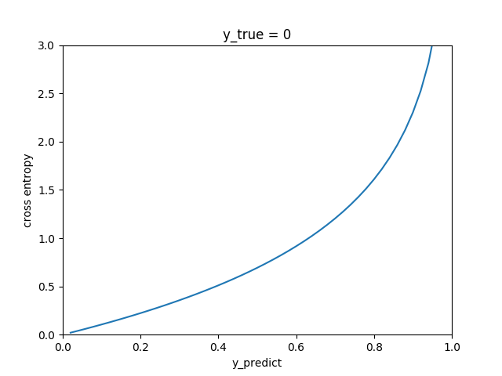
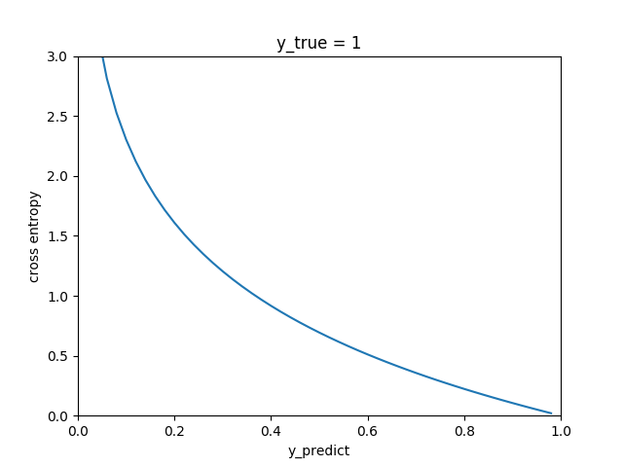
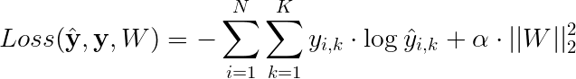
Logistic Regression & Neural Network: Learning
Binary problem:
Cross-entropy loss
L2 regularization
Multiclass problem:

Slide 37
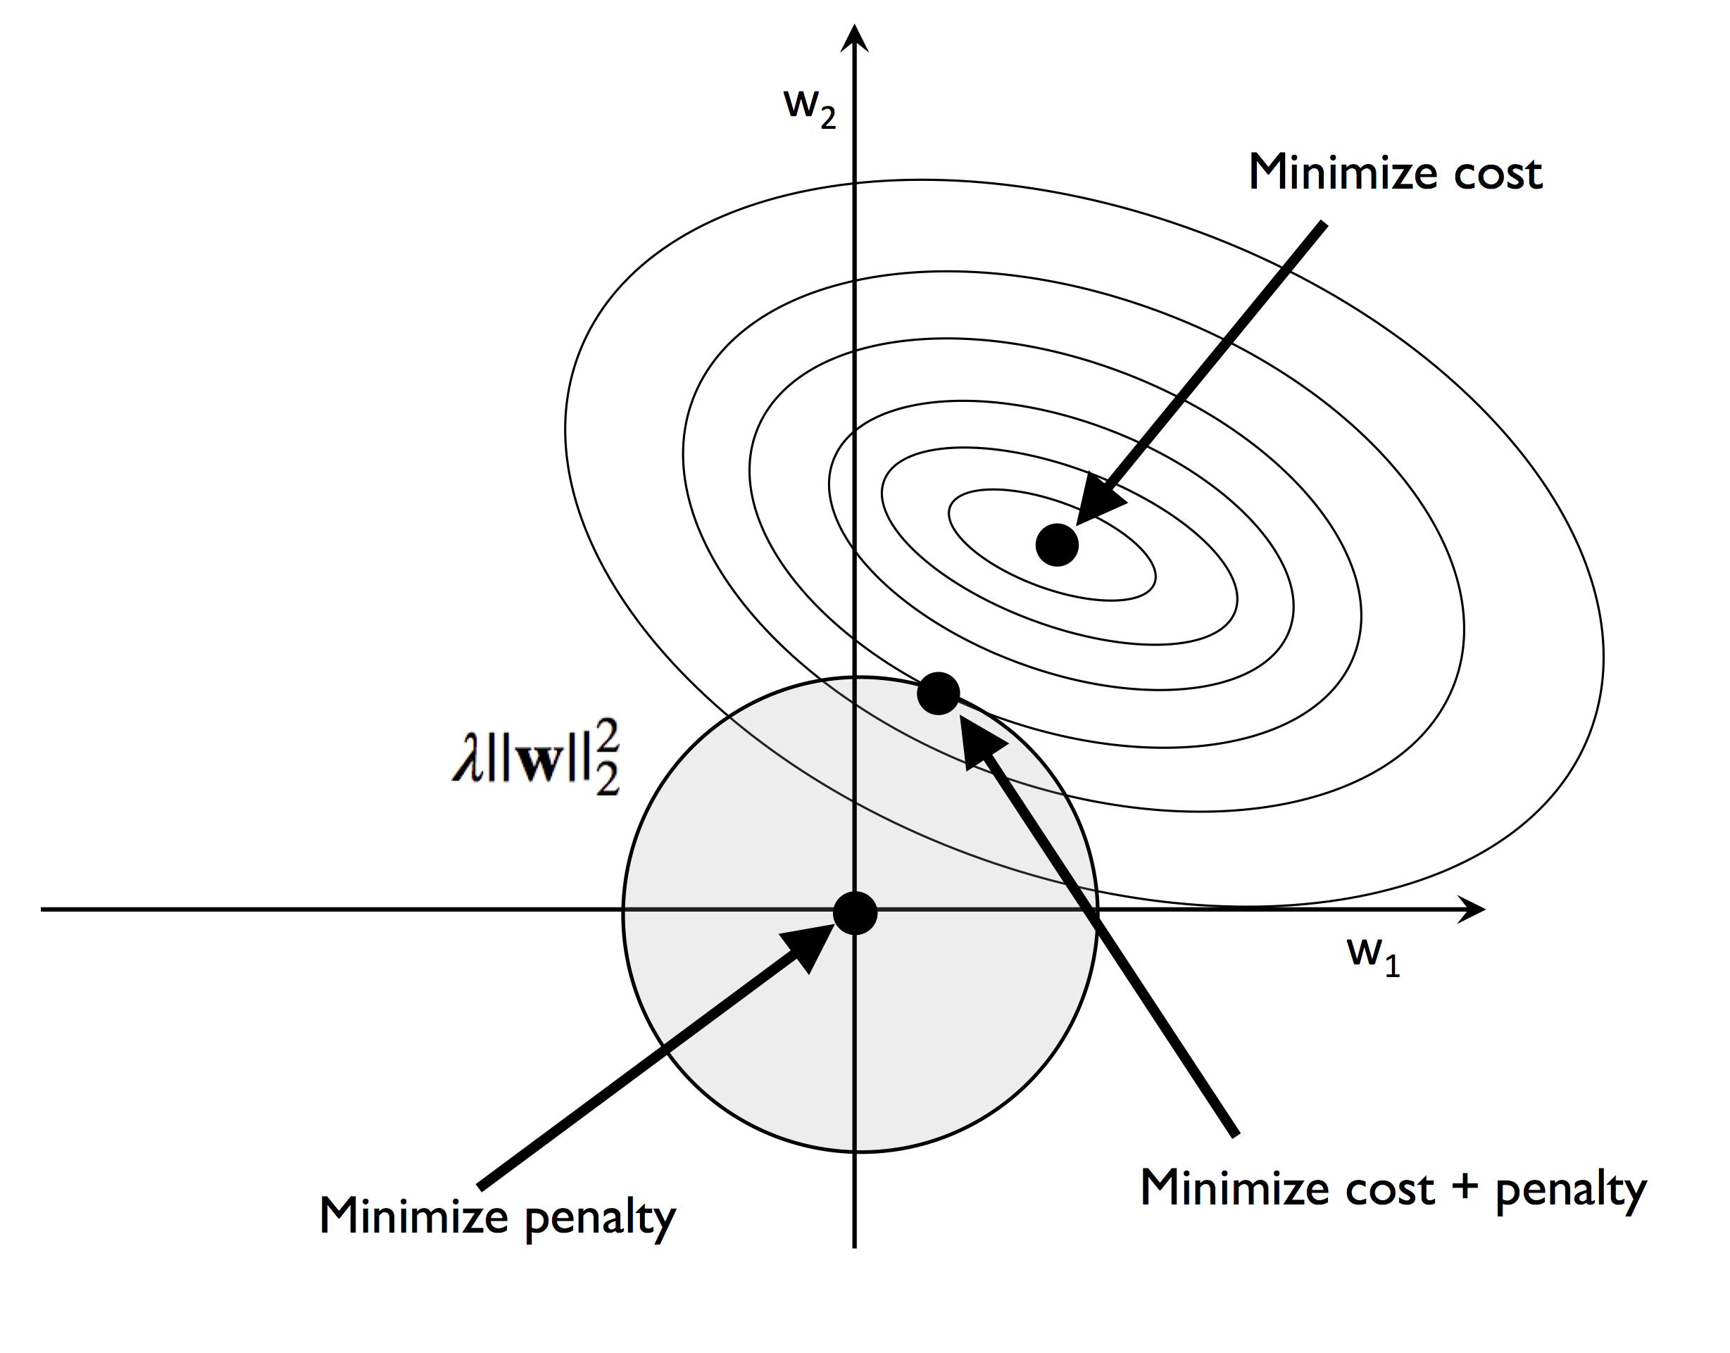
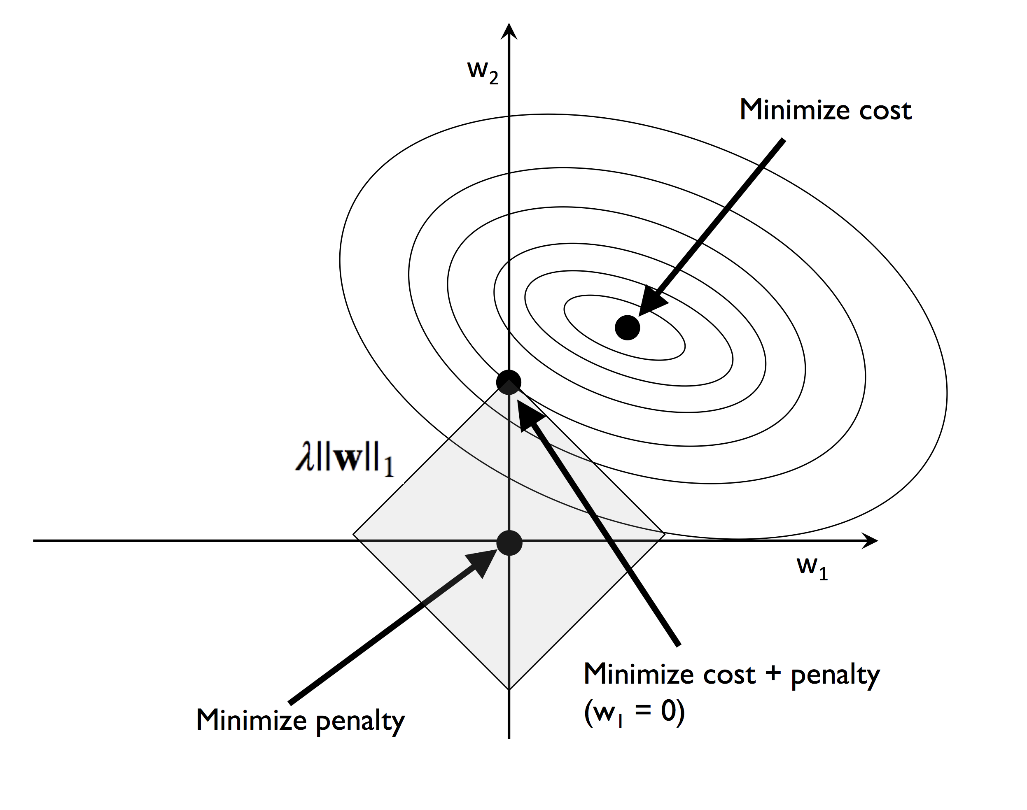
Regularization
L2 regularization:
L1 regularization:
Images from
https://github.com/rasbt/python-machine-learning-book-2nd-edition
S. Raschka and V. Mirjalili, Python Machine Learning (2nd Ed.)

Slide 38
Practice
Practice training logistic regression and neural network models in the ML4Bio software
Questions:
How does regularization strength affect learning?
Do different solvers produce the same decision boundary? Why? (Hint: local optima)
Is it always better to use more hidden units in a neural network?
What is the effect of learning rate in neural network learning?

Slide 39
Decision Tree: Representation and Inference
Exercises
no
yes
Age
No
< 30
≥ 30
Internal node
No
BMI
< 25.5
≥ 25.5
Leaf node
No
Yes

Slide 40
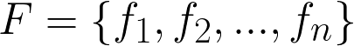











Decision Tree: Learning
Feature set
Classes
Measure of uncertainty:
Gini
Given training data of size at node ,
Entropy
For feature :
where
Split with feature that reduces uncertainty
the most:

Slide 41
Random Forest: Representation, Learning and Inference
Training data D
Sample D with replacement
(Bootstrap)
Set D₁
Set D₂
Set D_{T-1}
Set D_{T}
Feature Set F
T trees
Sample F without replacement at each node
Learning
……
Given a new sample x
+
+
……
-
+
Inference
Majority vote
+

Slide 42
Practice
Practice training decision tree and random forest models in the ML4Bio software
Questions:
What does the decision boundary produced by decision trees (DT) look like? Why? How about random forests (RF)?
Which algorithm performs better in general? DT or RF? Why?
If we let a DT to grow freely without any regularization, how would the data at each leaf node look like?
What other strategies can be applied to DT/RF learning to encourage generalization? (Hint: reduction in uncertainty)

Slide 43








Linear SVM: Representation, Learning and Inference
Objective function:
margin
Margin size
Slack penalty
subject to
slack
support vector
Given a new point ,

Slide 44










Kernel SVM: Representation
linear
RBF
polynomial
sigmoid

Slide 45
Practice
Practice training SVM models in the ML4Bio software
Questions:
Why can a kernel SVM learn nonlinear decision boundary?
How does margin size change in response to change in penalty strength of a linear SVM?
How does accuracy on training and validation data change as you vary the coefficient of RBF kernel?
Do you think kernel SVM is always better than linear SVM in practice? Why? (Hint: generalization)

Slide 46





K-Nearest Neighbors: Representation, Learning and Inference
Class 0 training point
Class 1 training point
New point
K = 3
K = 5
Find K training points
closest to the new point .
Measure of distance:
Manhattan distance
(L¹ distance)
Euclidean distance
(L² distance)

Slide 47
Practice
Practice training KNN models in the ML4Bio software
Questions:
As K increases, the decision boundary becomes smoother. Why?
Why is KNN not appropriate for data with a mixture of discrete and continuous data? (Hint: distance)
Does KNN work well in high-dimensional space? Why?

Slide 48





Naïve Bayes: Representation and Inference
y
Class
x₁
x₂
x₃
x₄
……
x_{n}
Features
(independence)
Discrete feature
Continuous feature

Slide 49




Naïve Bayes: Learning
Recall
To estimate :
To estimate :
Discrete feature
Continuous feature

Slide 50
Practice
Practice training Naïve Bayes models in the ML4Bio software
Questions:
For 2D continuous data with binary labels, the decision boundary produced by a NB classifier is a circle. Why? (Hint: distribution, independence)
How does class priors affect classification?
Can NB handle data with a mixture of discrete and continuous data? Why?
How would you encode categorical features in NB?

Slide 51
Step 3: Evaluation
Why do we only evaluate on the test set one time?

Slide 52
Step 4: Prediction
Trained models can make predictions on new unlabeled samples

Slide 53

Next Steps
Visit the accompanying guides
Ask questions on GitHub
Experiment with the Python notebook
Scikit-learn tutorials
Python Machine Learning book code examples
Jake VanderPlas tutorial
Prepare your data with Data Carpentry
Regression, unsupervised learning, feature engineering, and other topics we did not cover

Slide 54
Acknowledgements
ML consultants: Chris Magnano, Ross Kleiman, Zijie (Jay) Wang
Debora Treu
Megan McClean
Python Machine Learning book authors Sebastian Raschka and Vahid Mirjalili
NSF 1553206
Workshop participants

